Slide 1
RE2 Matching and Propensity Scores
UIUC ECON 474 Econometrics of Policy Evaluation

Slide 2
Overview
Next time: Designing experiments and effect size
Today: closing backdoors with conditioning strategies
Conditional independence assumption (CIA)
Subclassification
Exact matching
Approximate matching: propensity scores

Slide 3

Conditional Independence Assumption (CIA)

Slide 4
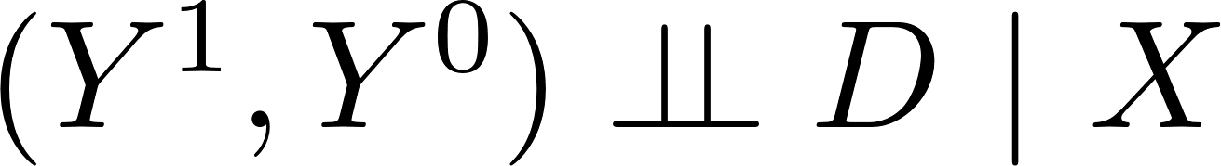
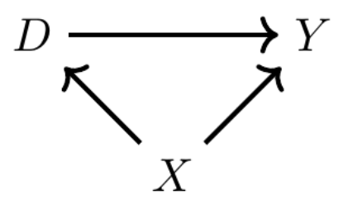
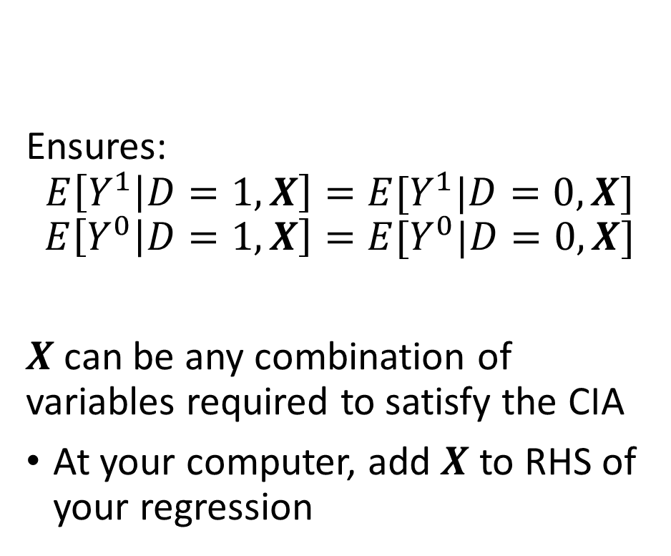
Conditional Independence Assumption (CIA)
Ensures:
$$E\left[Y^{1} | D=1,X\right]=E[Y^{1}|D=0,X]$$
$$E\left[Y^{0} | D=1,X\right]=E[Y^{0}|D=0,X]$$
$X$ can be any combination of variables required to satisfy the CIA
At your computer, add $X$ to RHS of your regression

Slide 5
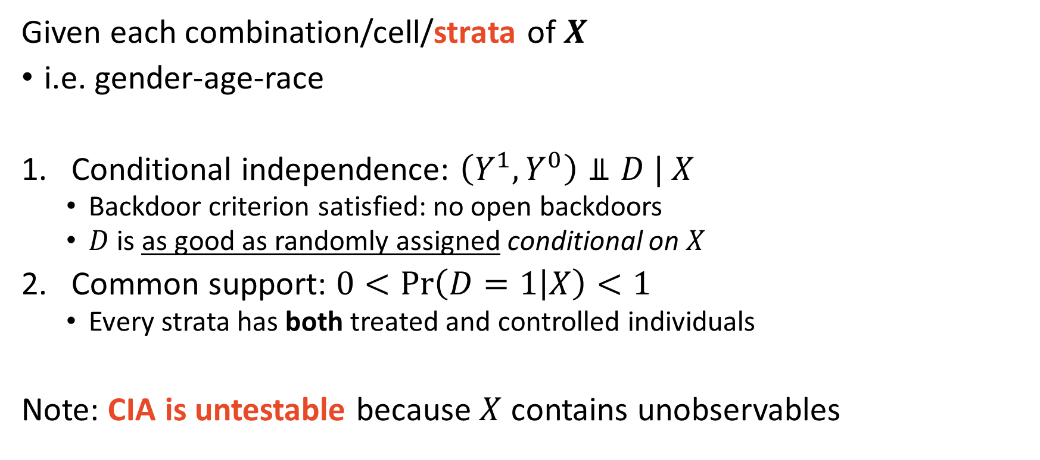
CIA Identifying Assumptions
Given each combination/cell/strata of $X$
i.e. gender-age-race
Conditional independence: $\left(Y^{1},Y^{0}\right)⫫D | X$
Backdoor criterion satisfied: no open backdoors
$D$ is as good as randomly assigned conditional on $X$
Common support: $0<\operatorname{Pr}\left(D=1 | X\right)<1$
Every strata has both treated and controlled individuals
Note: CIA is untestable because $X$ contains unobservables

Slide 6
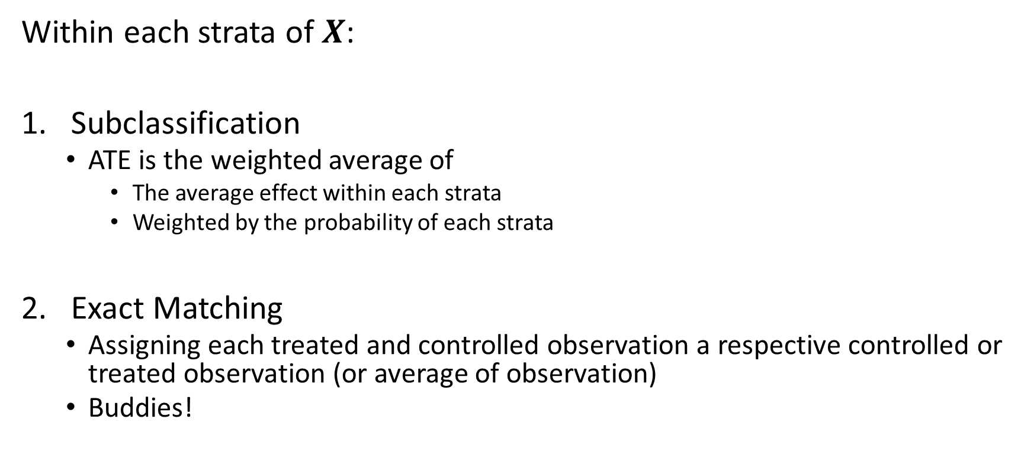
Two Basic Techniques to Satisfy CIA
Within each strata of $X$:
Subclassification
ATE is the weighted average of
The average effect within each strata
Weighted by the probability of each strata
Exact Matching
Assigning each treated and controlled observation a respective controlled or treated observation (or average of observation)
Buddies!

Slide 7
Subclassification
Weighted averages of group averages

Slide 8
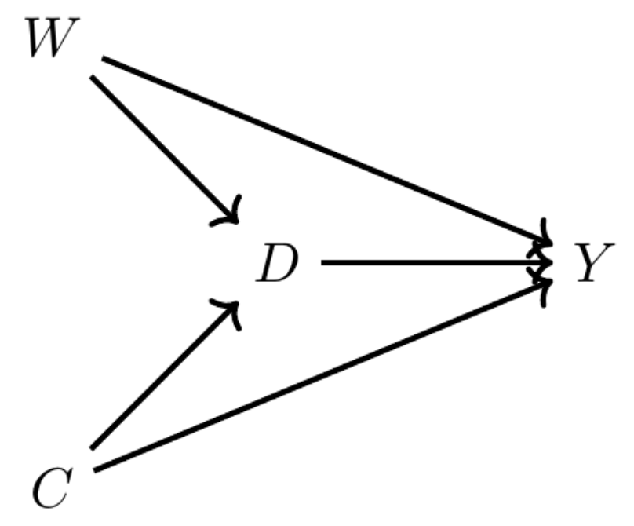
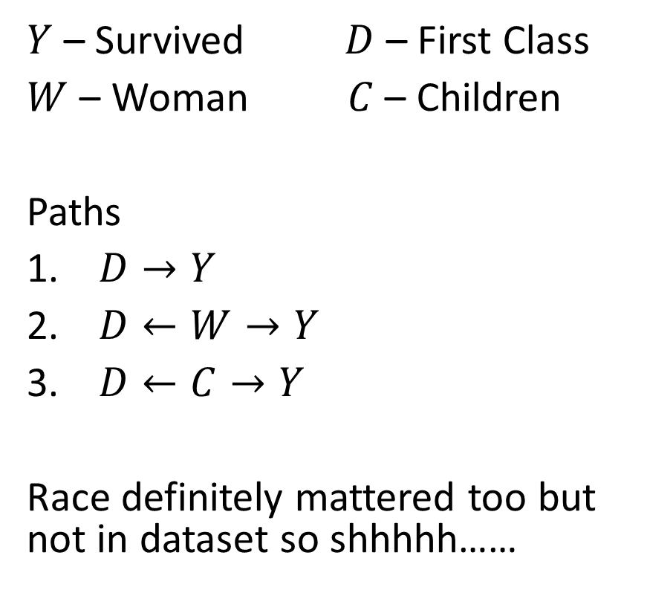
Example: First Class Titanic Passengers and Survival
$Y$ – Survived $D$ – First Class
$W$ – Woman $C$ – Children
Paths
$D→Y$
$D←W→Y$
$D←C→Y$
Race definitely mattered too but not in dataset so shhhhh……

Slide 9

Example: First Class Titanic Passengers and Survival

Slide 10
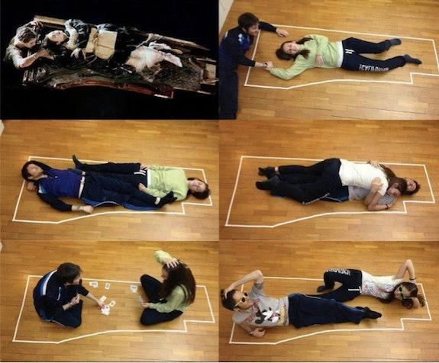
Example: First Class Titanic Passengers and Survival

Slide 11
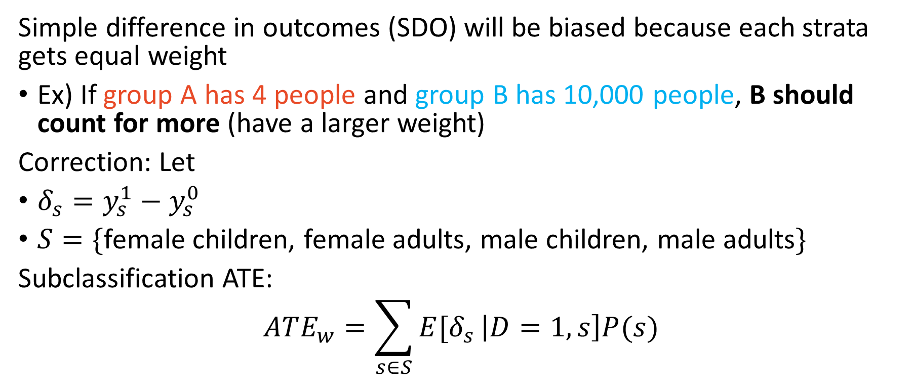
Anyway…. The point being….
Simple difference in outcomes (SDO) will be biased because each strata gets equal weight
Ex) If group A has 4 people and group B has 10,000 people, B should count for more (have a larger weight)
Correction: Let
$δ_{s}=y_{s}^{1}−y_{s}^{0}$
$S=\{$female children, female adults, male children, male adults$\}$
Subclassification ATE:
$$ATE_{w}=\sum_{s∈S}{E[δ_{s}}\left|D=1,s\right]P(s)$$

Slide 12
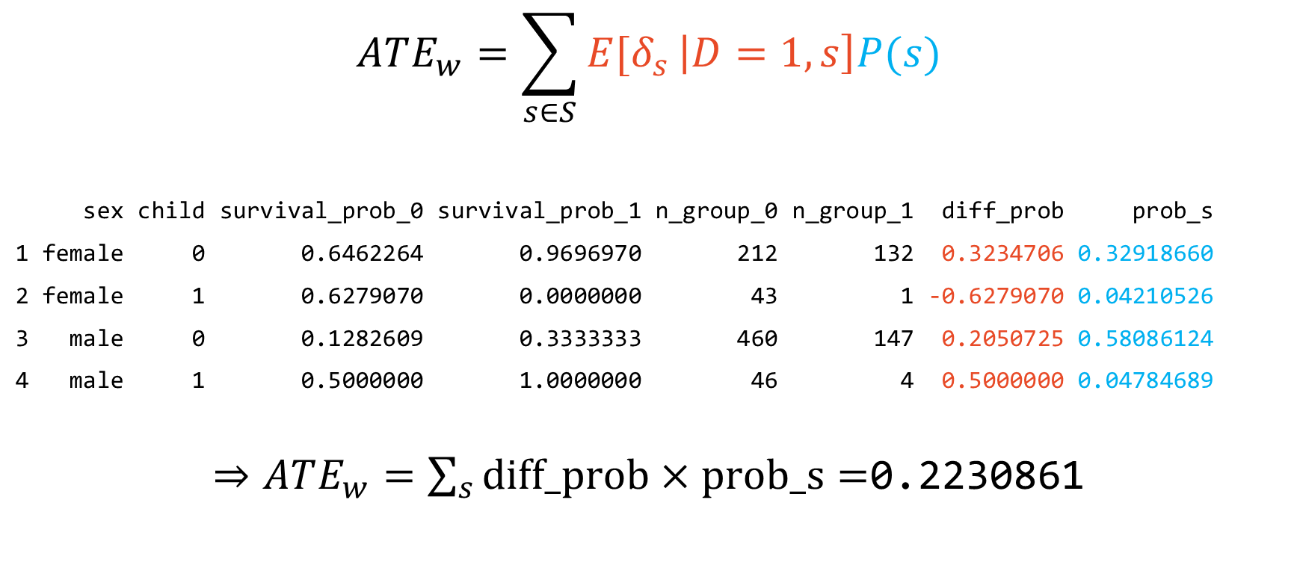
An example with the Titanic data
$$ATE_{w}=\sum_{s∈S}{E[δ_{s}}\left|D=1,s\right]P(s)$$
sex child survival_prob_0 survival_prob_1 n_group_0 n_group_1 diff_prob prob_s
1 female 0 0.6462264 0.9696970 212 132 0.3234706 0.32918660
2 female 1 0.6279070 0.0000000 43 1 -0.6279070 0.04210526
3 male 0 0.1282609 0.3333333 460 147 0.2050725 0.58086124
4 male 1 0.5000000 1.0000000 46 4 0.5000000 0.04784689
$⇒ATE_{w}=\sum_{s}{diff_prob}×prob_s=$0.2230861

Slide 13
Curse of dimensionality
sex age survival_prob_0 survival_prob_1 n_group_0 n_group_1 diff
1 female 1 0.88888889 NA 9 NA NA
2 female 2 0.33333333 0.0000000 6 1 -0.33333333
3 female 3 0.33333333 NA 3 NA NA
4 female 4 1.00000000 NA 5 NA NA
5 female 5 1.00000000 NA 4 NA NA
6 female 6 0.50000000 NA 2 NA NA
... ... ... ... ... ... ... ...
Subclassification cannot be used to condition on variables with many values (e.g., age) due to common support requirement
Need both treated and untreated observations in each strata

Slide 14
Exact Matching
Buddies! Or averages of Buddies! Wait, how do you average a buddy?

Slide 15
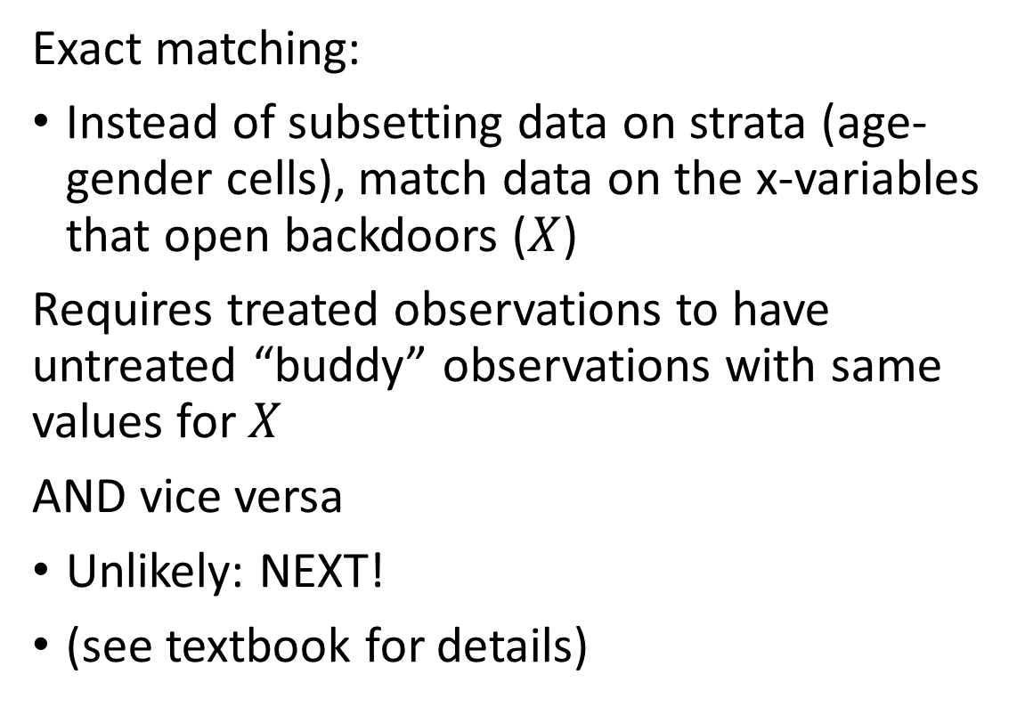
Exact matching uses covariates instead of strata
Exact matching:
Instead of subsetting data on strata (age-gender cells), match data on the x-variables that open backdoors ($X$)
Requires treated observations to have untreated “buddy” observations with same values for $X$
AND vice versa
Unlikely: NEXT!
(see textbook for details)

Slide 16
Approximate Matching
Matching on treatment observations with control observations that look like treatment observations

Slide 17
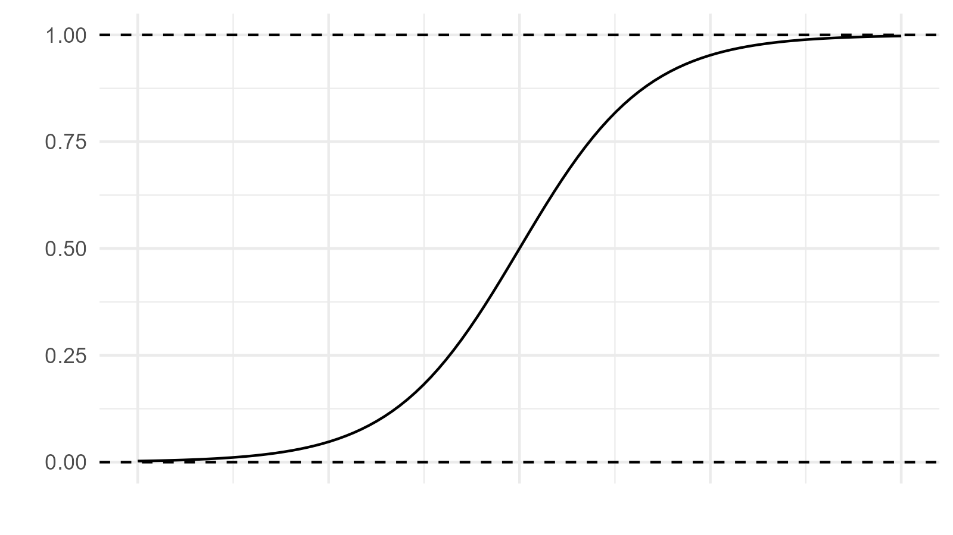
Propensity scores are from logistic regression
Approximate matching:
Instead of finding exact buddy matches, find approximate matches
Specifically, untreated observations that are near treated observations
“Nearest neighbors”
Solution:
predict likelihood/propensity of being in treatment group

Slide 18
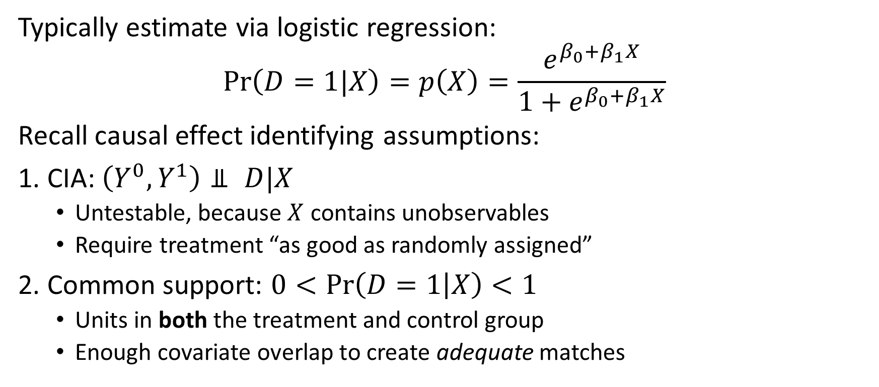
Propensity Scores
Typically estimate via logistic regression:
$$\operatorname{Pr}\left(D=1|X\right)=p\left(X\right)=\frac{e^{β_{0}+β_{1}X}}{1+e^{β_{0}+β_{1}X}}$$
Recall causal effect identifying assumptions:
1. CIA: $\left(Y^{0},Y^{1}\right)⫫ D|X$
Untestable, because $X$ contains unobservables
Require treatment “as good as randomly assigned”
2. Common support: $0<\operatorname{Pr}\left(D=1 | X\right)<1$
Units in both the treatment and control group
Enough covariate overlap to create adequate matches

Slide 19
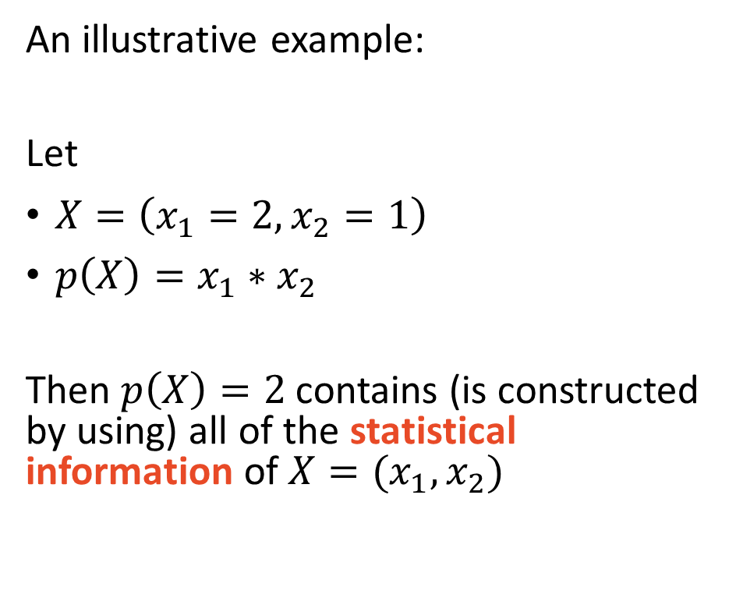
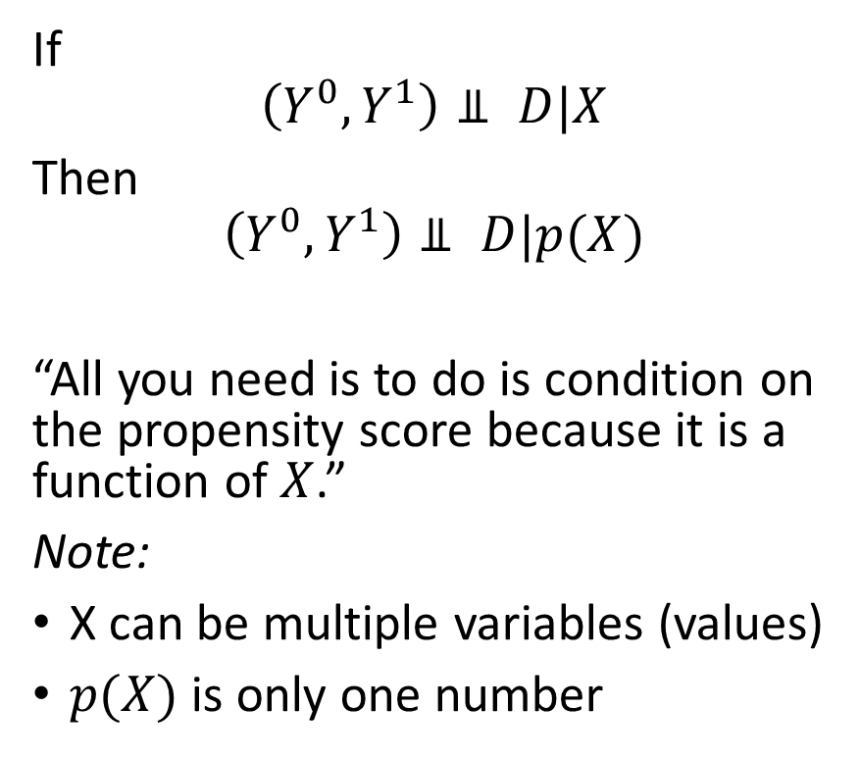
Propensity Score Theorem (PST)
If
$$\left(Y^{0},Y^{1}\right)⫫ D|X$$
Then
$$\left(Y^{0},Y^{1}\right)⫫ D|p(X)$$
“All you need is to do is condition on the propensity score because it is a function of $X$.”
Note:
X can be multiple variables (values)
$p(X)$ is only one number
An illustrative example:
Let
$X=\left(x_{1}=2,x_{2}=1\right)$
$p\left(X\right)=x_{1}∗x_{2}$
Then $p\left(X\right)=2$ contains (is constructed by using) all of the statistical information of $X=(x_{1},x_{2})$

Slide 20
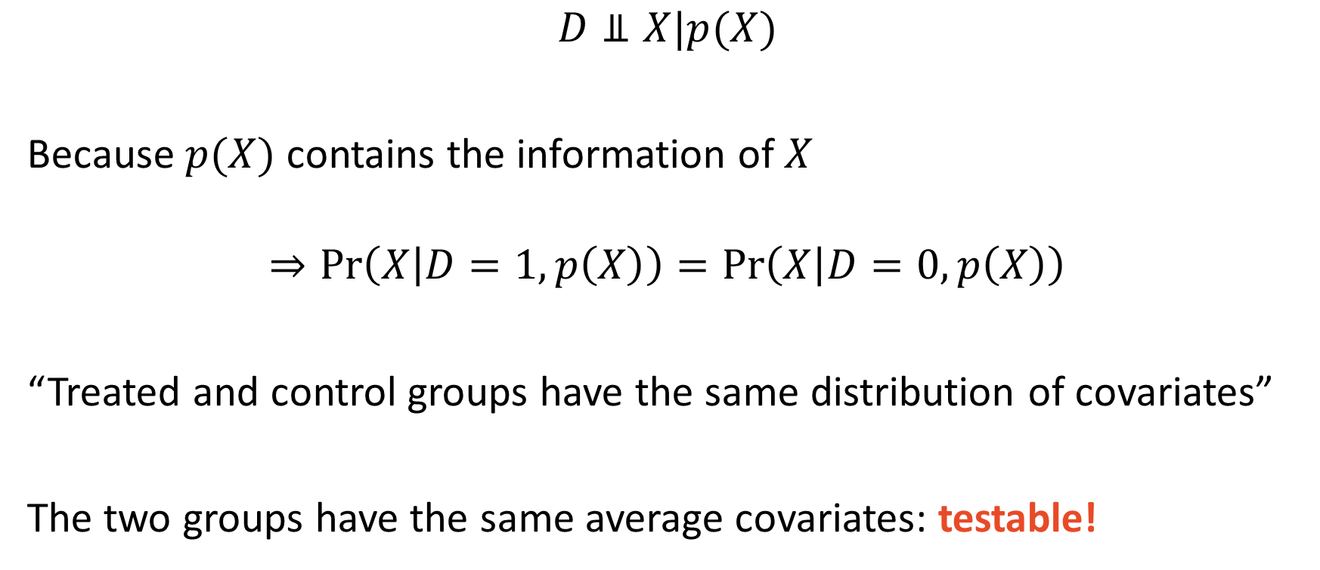
PST Balancing Property
$$D⫫X|p(X)$$
Because $p(X)$ contains the information of $X$
$$⇒\operatorname{Pr}\left(X | D=1,p\left(X\right)\right)=\operatorname{Pr}\left(X | D=0,p\left(X\right)\right)$$
“Treated and control groups have the same distribution of covariates”
The two groups have the same average covariates: testable!

Slide 21
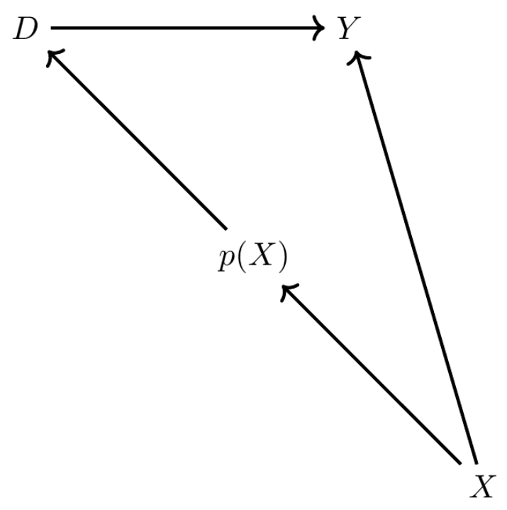
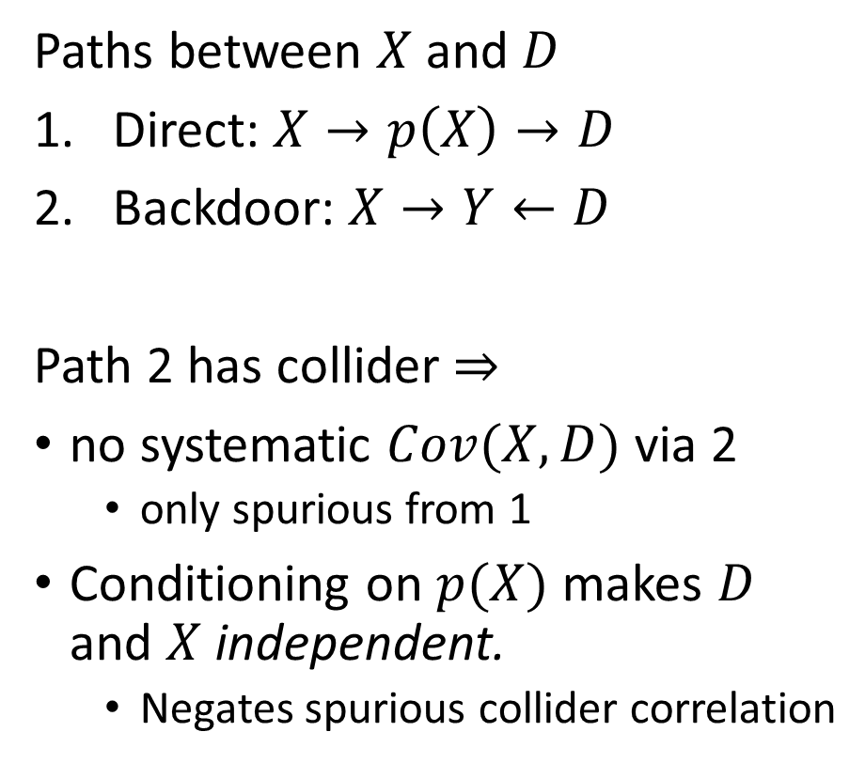
Dagnabbit, another DAG!
Paths between $X$ and $D$
Direct: $X→p\left(X\right)→D$
Backdoor: $X→Y←D$
Path 2 has collider $⇒$
no systematic $Cov(X,D)$ via 2
only spurious from 1
Conditioning on $p(X)$ makes $D$ and $X$ independent.
Negates spurious collider correlation

Slide 22

Propensity Score Matching
Match treated with $n$ nearest neighbors

Slide 23
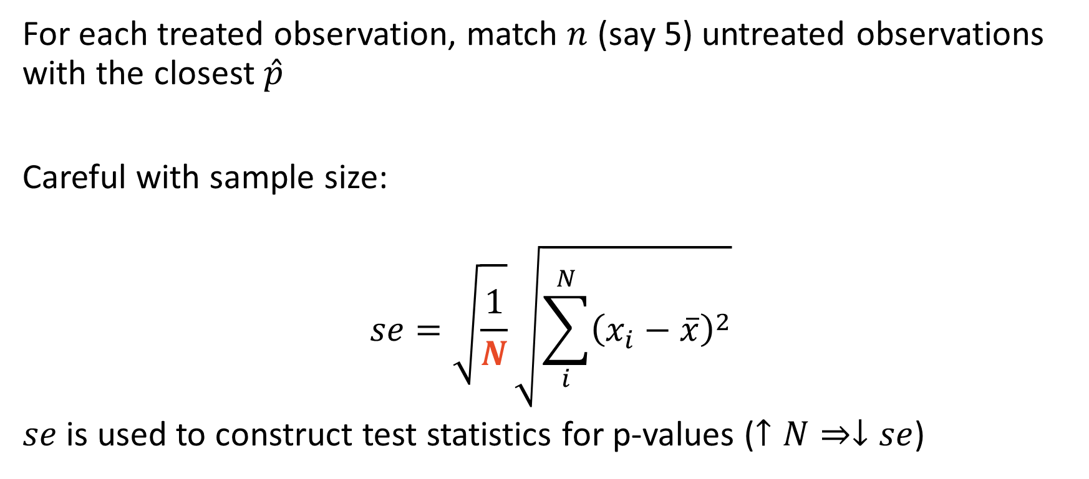
Nearest-Neighbor Propensity Score Matching
For each treated observation, match $n$ (say 5) untreated observations with the closest $\hat{p}$
Careful with sample size:
$$se=\sqrt{\frac{1}{N}}\sqrt{\sum_{i}^{N}{{\left(x_{i}−\overline{x}\right)}^{2}}}$$
$se$ is used to construct test statistics for p-values ($↑N⇒↓se$)

Slide 24
Coding Example: Lalonde (1986)
National Supported Work Demonstration (NSW) job-training program
1970s: program admitted
Women receiving Aid to Families with Dependent Children
Recovering addicts
Released offenders
Men and women of both sexes who had not completed high school
Lalonde (1986) used observational data as control group
Control group relative to treated group
Smaller proportion black and Hispanic, older, more likely married, higher educated, higher earnings, higher levels of employment
Cringe….

Slide 25
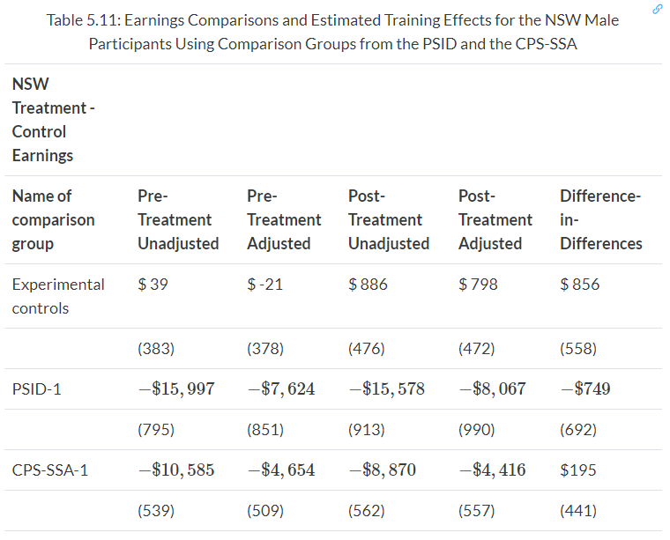

Coding Example: Lalonde (1986)
$←$ estimates are all over the place
Selection bias
Can we fix it?

Slide 26
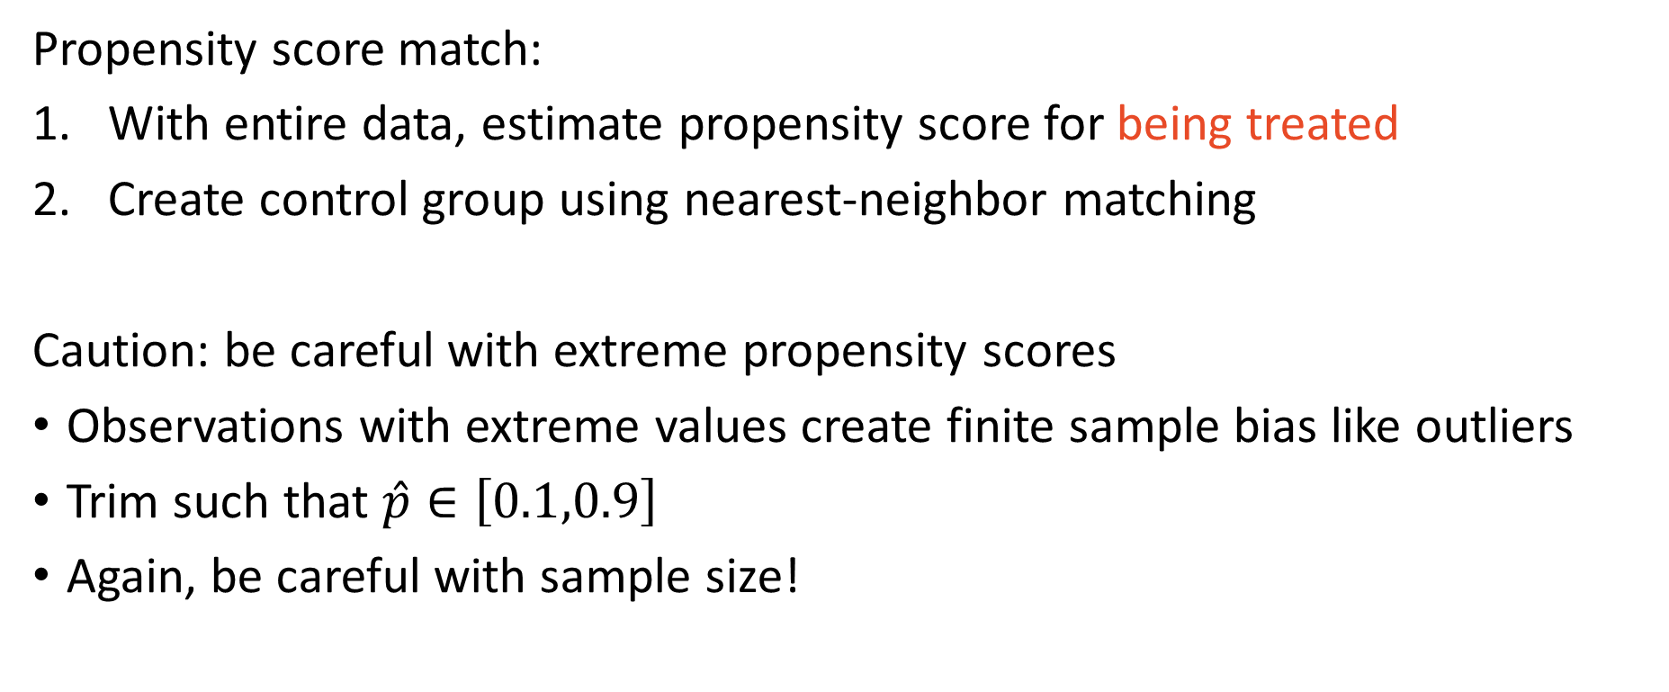
Empirical Approach
Propensity score match:
With entire data, estimate propensity score for being treated
Create control group using nearest-neighbor matching
Caution: be careful with extreme propensity scores
Observations with extreme values create finite sample bias like outliers
Trim such that $\hat{p}∈\left[0.1,0.9\right]$
Again, be careful with sample size!

